Slide 1
Search
Queries and Index structures

Slide 2
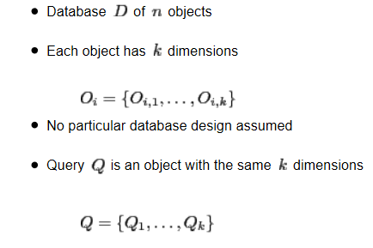
General Setting

Slide 3
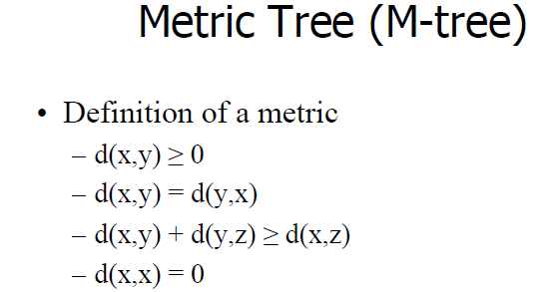
Distance function

Slide 4
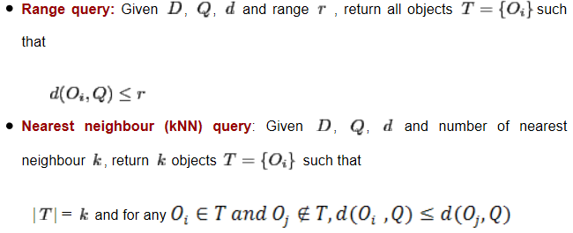
Similarity Search

Slide 5
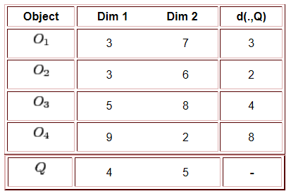
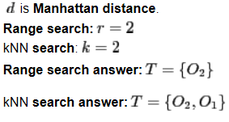
Similarity Search: Example

Slide 6
Applications
Top-k
Cab service (Ex. Uber, Ola)
Range Search
Serviceable restaurant in Swiggy/Zomato
Computationally, which one is harder?
Range query: O(n)
Top-k: O(nlog k)

Slide 7
KD Tree

Slide 8
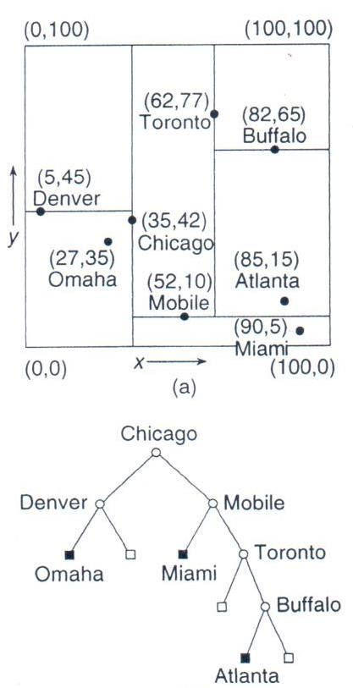
Structure
Object | x,y
Chicago | 35,42
Mobile | 52,10
Toronto | 62,77
Buffalo | 82,65
Denver | 5,45
Omaha | 27,35
Atlanta | 85,15
Miami | 90,5
At level i, split on dimension (i Mod d)+1
d is the number of dimensions
We will assume 2D, but as you can see it is easy to generalize to higher dimensions

Slide 9
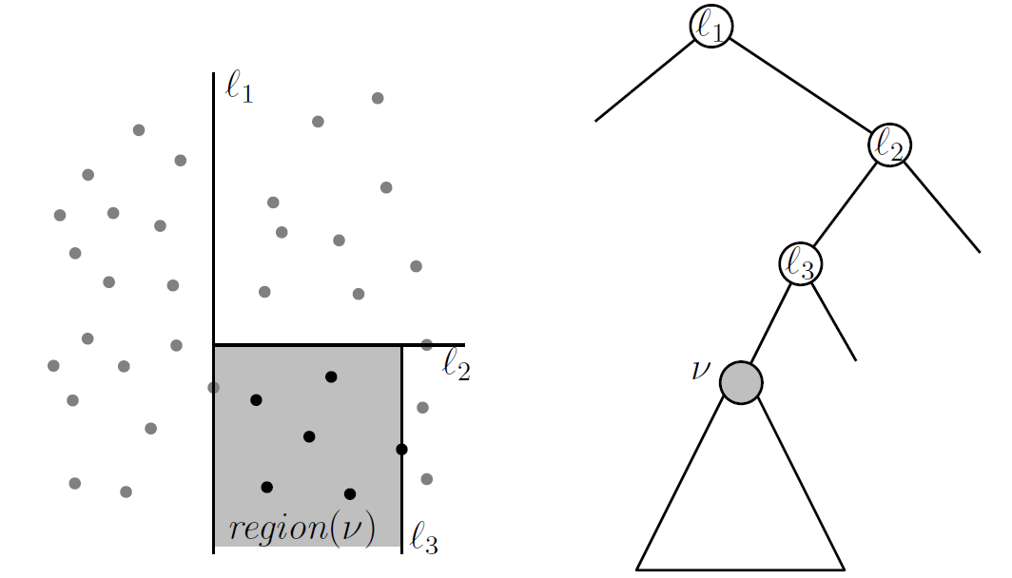
Properties
Each subtree represents a grid
Not balanced
Bulk-load to create balanced KD tree
Split on median
Storage
O(n)
Construction time
For bulk-loading: O(nlogn) to presort points in each dimension
Depth is O(logn). Thus, inserting all points take O(nlogn)

Slide 10
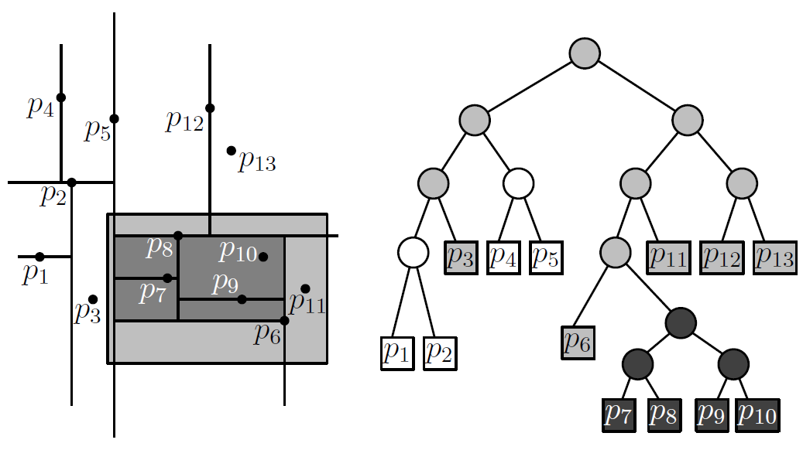
Searching
Point Query
Choose the branch with the possibility of containing the point
Cost
O(log n)
Range Search
Identify all regions (or subtrees) that intersect or lie the query region

Slide 11
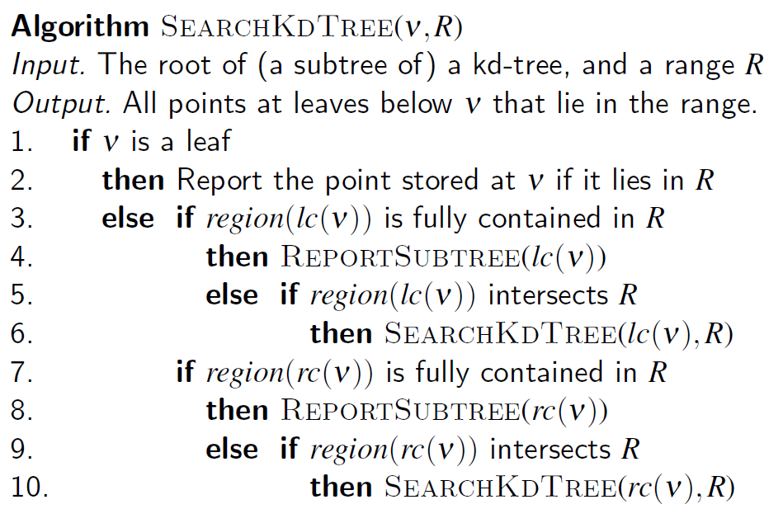
Range Search algorithm
Start from the root. For each children check
If completely within query region, report entire subtree
If intersects query region, recurse
Else ignore this children

Slide 12
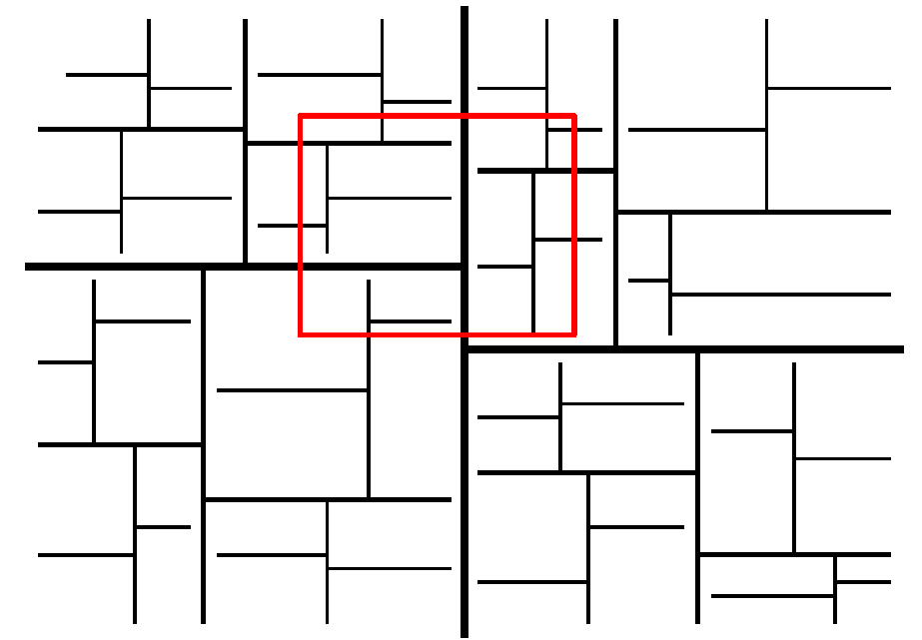
Range Search: Computation Cost
Two situations
Subtree entirely within query region
Cost?
O(k), k is size of subtree
Subtree intersects query region
Cost?
How many regions will intersect?

Slide 13
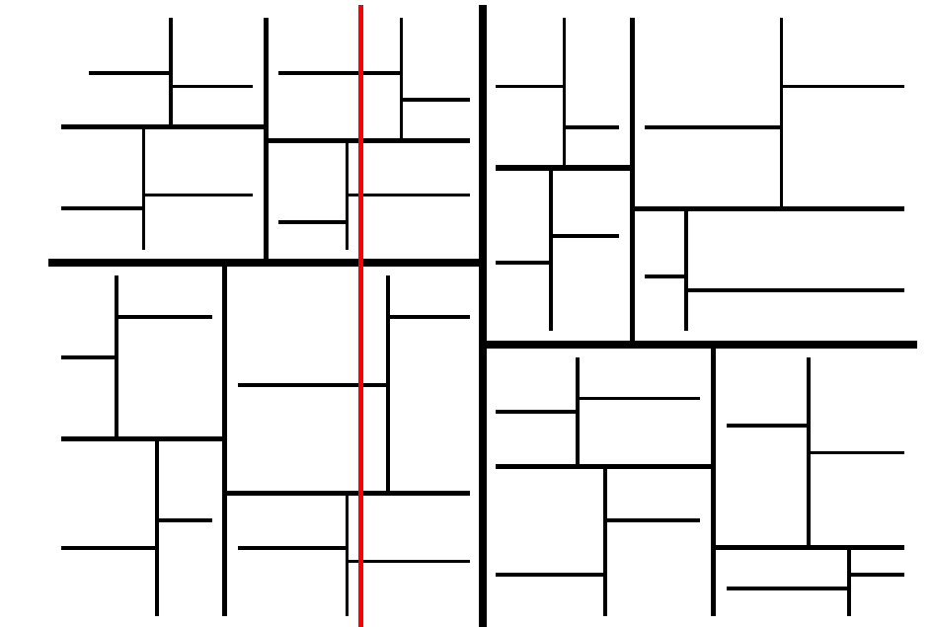
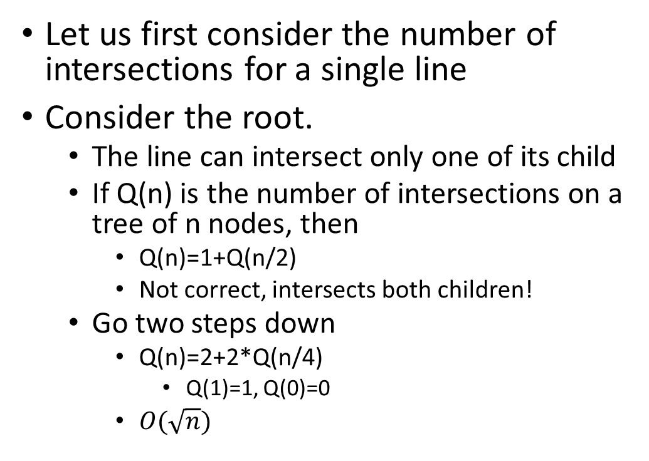
Number of intersections
Let us first consider the number of intersections for a single line
Consider the root.
The line can intersect only one of its child
If Q(n) is the number of intersections on a tree of n nodes, then
Q(n)=1+Q(n/2)
Not correct, intersects both children!
Go two steps down
Q(n)=2+2*Q(n/4)
Q(1)=1, Q(0)=0
$O(\sqrt{n})$

Slide 14
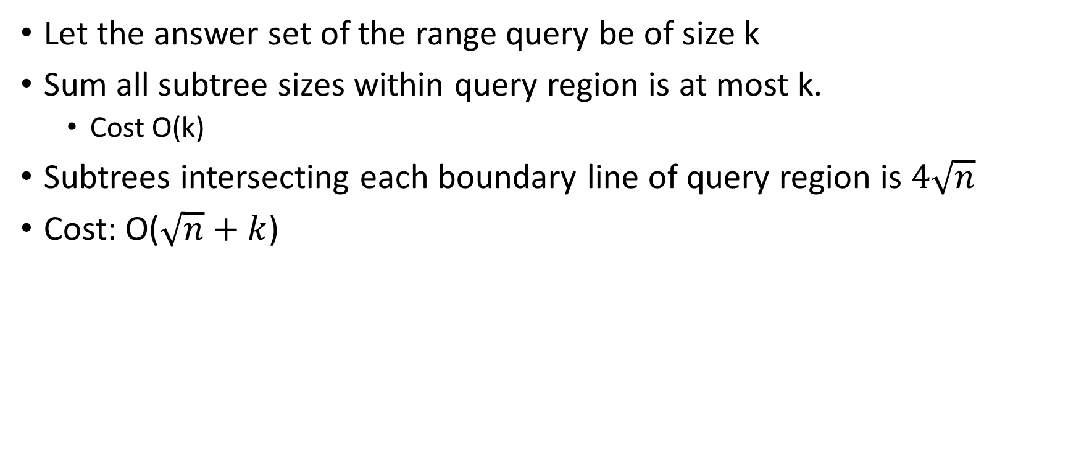
Computation Cost
Let the answer set of the range query be of size k
Sum all subtree sizes within query region is at most k.
Cost O(k)
Subtrees intersecting each boundary line of query region is $4\sqrt{n}$
Cost: O($\sqrt{n}+k$)

Slide 15
Range Tree
Range query complexity: O(log^{d-1} n)
d: dimension
n: number of points
Limitations (Both KD-tree and Range tree)
Cannot handle data updates easily
Insert: only at leaf level. May make the tree highly disbalanced
Deletes: Very complicated when a non-leaf node is deleted

Slide 16
Beyond Vector Spaces
What if we don’t have a way to convert objects into vectors?
Examples?
Graphs
Strings
Hamming Distance/Edit Distance
Sets of points
Hausdorff distance

Slide 17
Ciaccia, Paolo; Patella, Marco; Zezula, Pavel (1997). "M-tree An Efficient Access Method for Similarity Search in Metric Spaces". VLDB, 1997

Slide 18
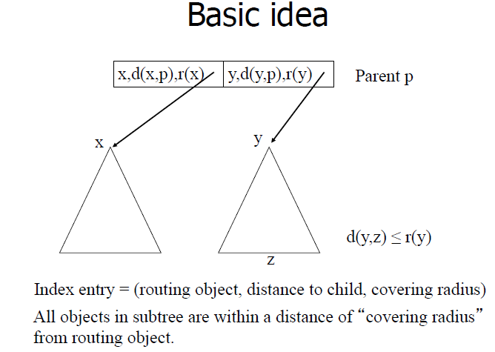

Slide 19
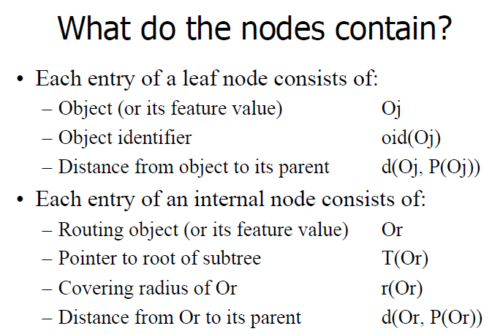

Slide 20
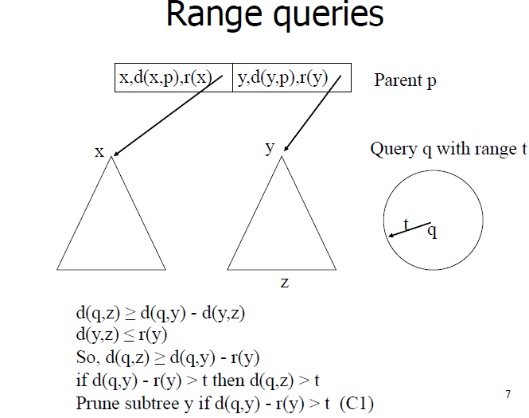

Slide 21
How about k-NN queries?

Slide 22
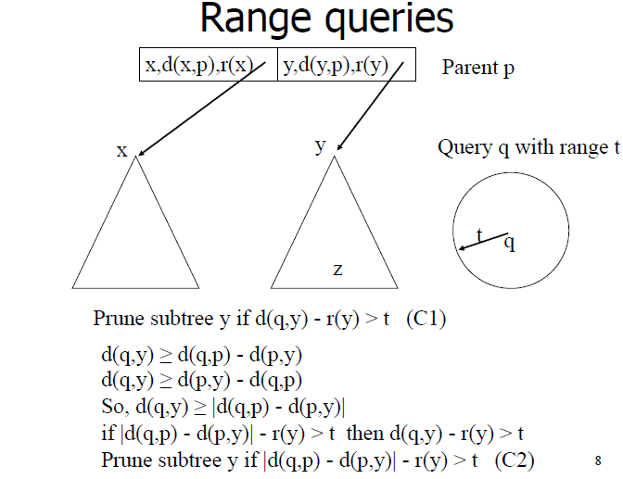

Slide 23
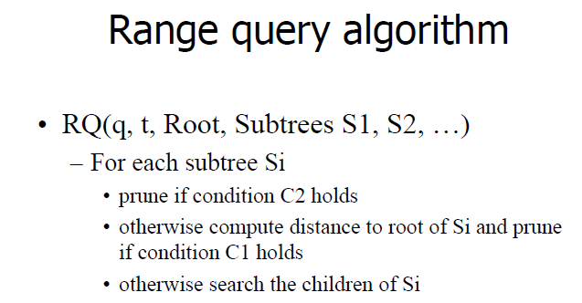

Slide 24
Curse of Dimensionality

Slide 25
Curse of dimensionality
What does this mean?
High dimensions are bad?
Why?
Bad for what?

Slide 26
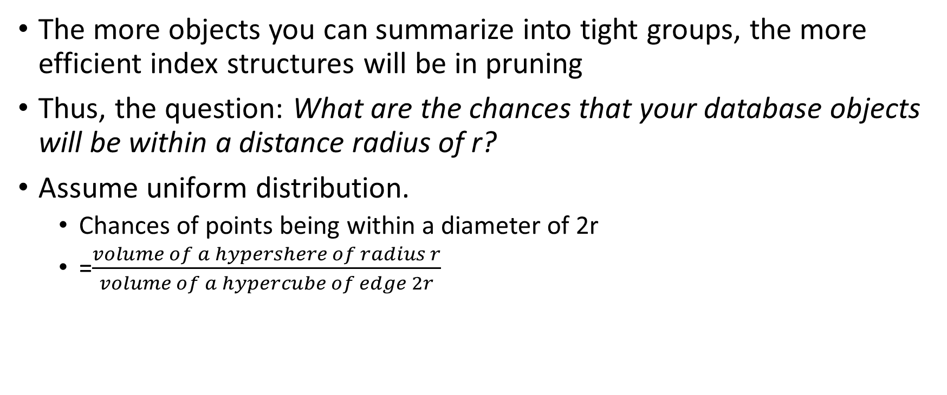
Efficiency of triangular inequality
The more objects you can summarize into tight groups, the more efficient index structures will be in pruning
Thus, the question: What are the chances that your database objects will be within a distance radius of r?
Assume uniform distribution.
Chances of points being within a diameter of 2r
=$\frac{volume of a hypershere of radius r}{volume of a hypercube of edge 2r}$

Slide 27

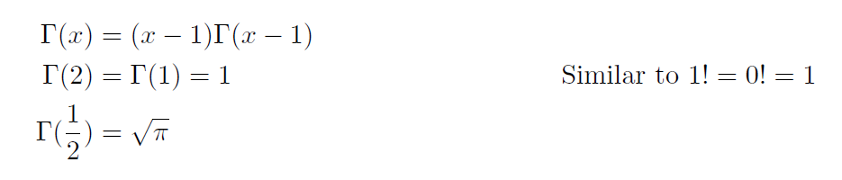
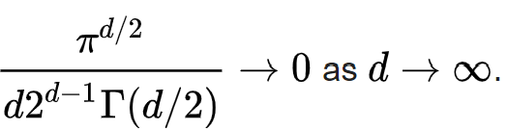
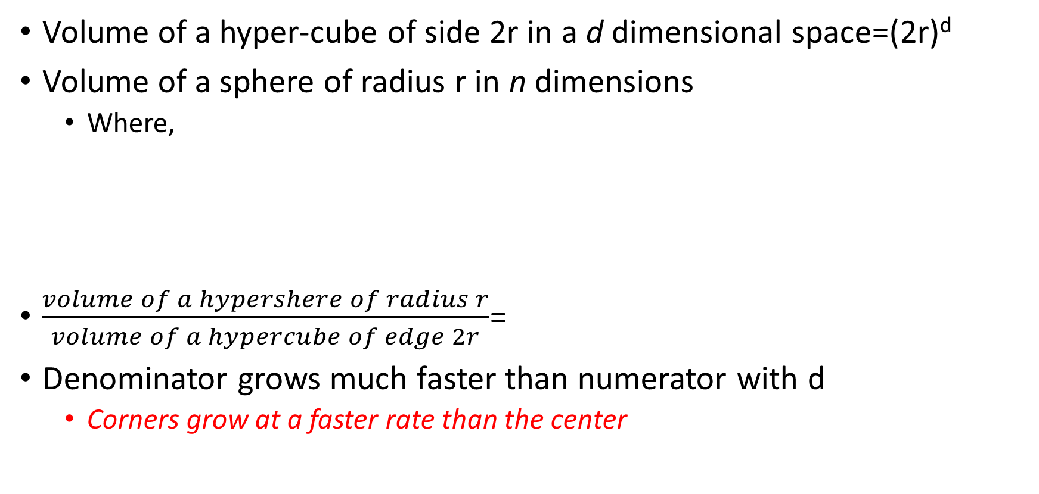
Hyper-sphere to Hyper-cube ratio
Volume of a hyper-cube of side 2r in a d dimensional space=(2r)^{d}
Volume of a sphere of radius r in n dimensions
Where,
$\frac{volume of a hypershere of radius r}{volume of a hypercube of edge 2r}$=
Denominator grows much faster than numerator with d
Corners grow at a faster rate than the center

Slide 28
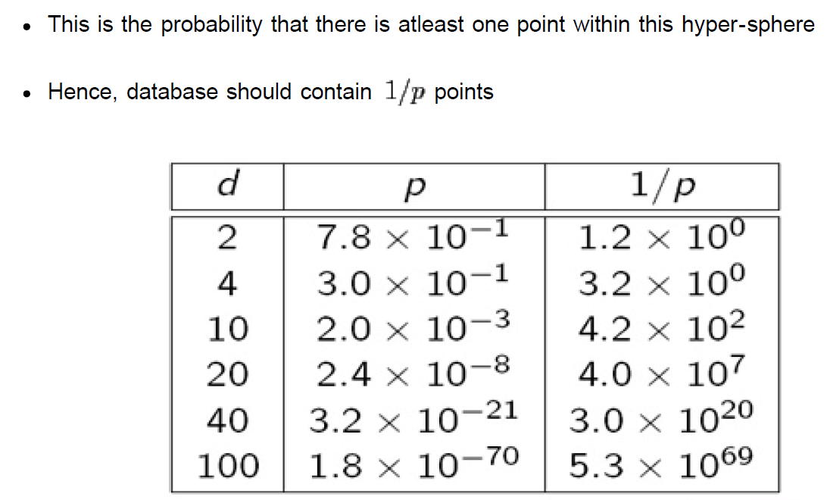
Numbers

Slide 29
Visualization
Hyper-cube
Sphere

Slide 30
MinHash

Slide 31
Set Similarity
Set Similarity (Jaccard measure)
Example
C₁ C₂
0 1
1 0
1 1 sim_{J}(C₁,C₂) = 2/5 = 0.4
0 0
1 1
0 1

Slide 32
Identifying Similar Sets?
Signature Idea
Hash columns C_{i} to signature sig(C_{i})
sim_{J}(C_{i},C_{j}) approximated by sim_{H}(sig(C_{i}),sig(C_{j}))
Naïve Approach
Sample P rows uniformly at random
Define sig(C_{i}) as P bits of C_{i} in sample
Problem
sparsity → would miss interesting part of columns
sample would get only 0’s in columns

Slide 33
Key Observation
For columns C_{i}, C_{j}, four types of rows
C_{i} C_{j}
A 1 1
B 1 0
C 0 1
D 0 0
Overload notation: A = # of rows of type A

Slide 34
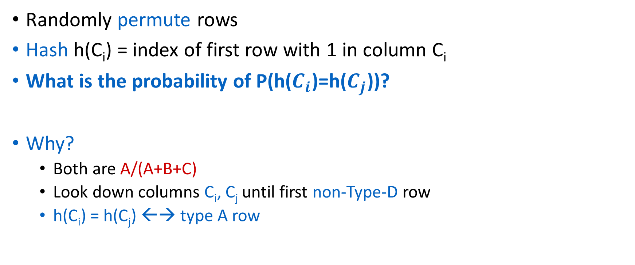
Min Hashing
Randomly permute rows
Hash h(C_{i}) = index of first row with 1 in column C_{i}
What is the probability of P(h($C_{i}$)=h($C_{j}$))?
Why?
Both are A/(A+B+C)
Look down columns C_{i}, C_{j} until first non-Type-D row
h(C_{i}) = h(C_{j}) ←→ type A row

Slide 35
Min-Hash Signatures
Pick – P random row permutations
MinHash Signature
sig(C) = list of P indexes of first rows with 1 in column C
Similarity of signatures
Let sim_{H}(sig(C_{i}),sig(C_{j})) = fraction of permutations where MinHash values agree
Observe E[sim_{H}(sig(C_{i}),sig(C_{j}))] = sim_{J}(C_{i},C_{j})

Slide 36
Example
Signatures
S₁ S₂ S₃
Perm 1 = (12345) 1 2 1
Perm 2 = (54321) 4 5 4
Perm 3 = (34512) 3 5 4
C₁ C₂ C₃
R₁ 1 0 1
R₂ 0 1 1
R₃ 1 0 0
R₄ 1 0 1
R₅ 0 1 0
Similarities
1-2 1-3 2-3
Col-Col 0.00 0.50 0.25
Sig-Sig 0.00 0.67 0.00

Slide 37
What does MinHash speed up?
Speeds up similarity function computation
Complexity of range queries remain same
Solution: Locality Sensitive Hashing

Slide 38
Locality Sensitive Hashing
(Approximate nearest neighbors: Towards removing the curse of dimensionality, STOC 98)

Slide 39
Goal
Extend hashing for k-NN and range queries
Use a special class of proximity-preserving hash functions
Similar objects have similar hashcodes
Is MOD proximity-preserving?
Is binning/gridding proximity preserving?
MinHash?

Slide 40
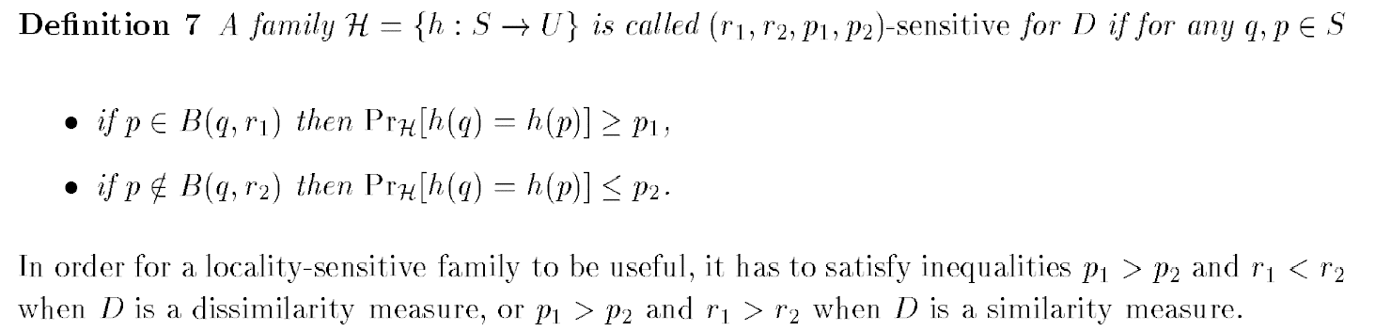
Proximity preserving hash-function
B(q,r) is a ball of radius r around a point q

Slide 41
Where do I get proximity hash-functions from?
Some known functions
Bit projection in Hamming Space
P-stable distributions
Min-hash

Slide 42
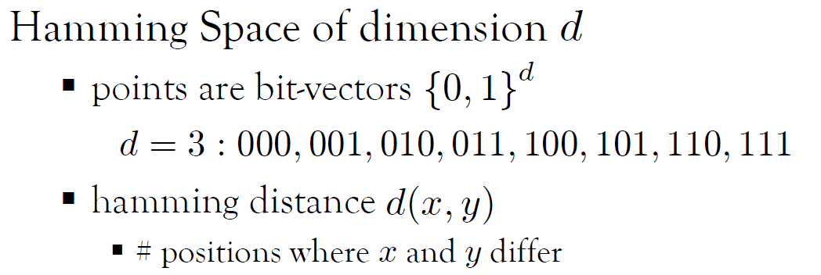
Hamming Space

Slide 43
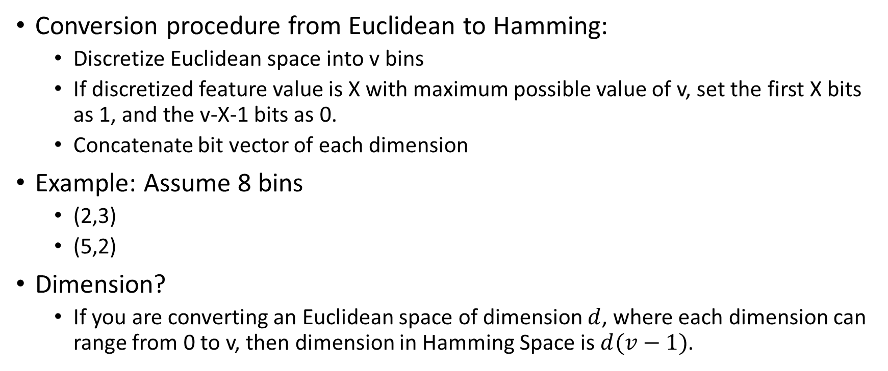
Euclidean to Hamming
Conversion procedure from Euclidean to Hamming:
Discretize Euclidean space into v bins
If discretized feature value is X with maximum possible value of v, set the first X bits as 1, and the v-X-1 bits as 0.
Concatenate bit vector of each dimension
Example: Assume 8 bins
(2,3)
(5,2)
Dimension?
If you are converting an Euclidean space of dimension $d$, where each dimension can range from 0 to v, then dimension in Hamming Space is $d(v−1)$.

Slide 44
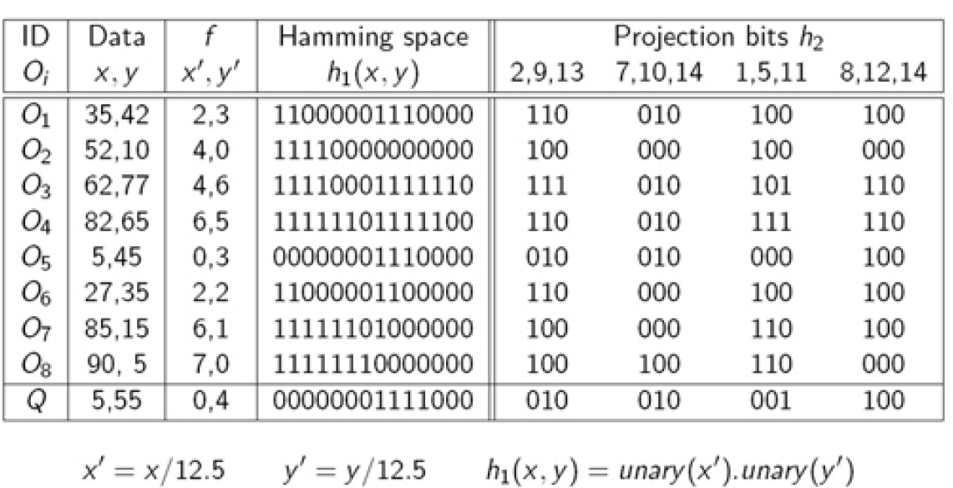
Euclidean to Hamming Space

Slide 45
K-NN query
Convert query q to Hamming space
Hash using each function
Sort objects based on the number of times they collide with q
Return answer

Slide 46
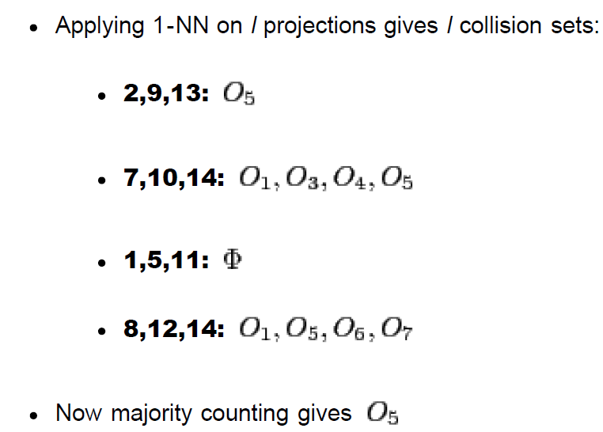
1-NN

Slide 47
LSH algorithm
Create a table with H proximity-preserving hash functions
Now create L such tables
A data point p collides with query q, if there is a collision across all hash functions in some table.
Obtain up to mL collision points and re-compute the correct answer from only this set.
Why mL will get clear after proof.

Slide 48
Complexity: Indexing
n points of dimension d
H hash functions
L hash tables
f is the number of bins in hamming space per dimension
Computation cost
Conversion to Hamming space: O(ndf)
Hashing: O(nHL)
Storage
O(nd)+O(nHL)

Slide 49
Complexity: querying time
n points of dimension d
H hash functions
L hashtables
Computation Cost:
O(df+HL+mL)

Slide 50
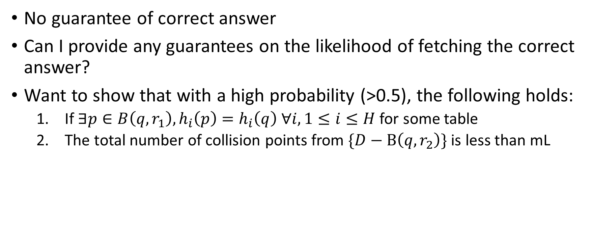
Properties
No guarantee of correct answer
Can I provide any guarantees on the likelihood of fetching the correct answer?
Want to show that with a high probability (>0.5), the following holds:
If $∃p∈B\left(q,r_{1}\right), h_{i}\left(p\right)=h_{i}\left(q\right) ∀i, 1≤i≤H$ for some table
The total number of collision points from $\{D−B\left(q,r_{2}\right)\}$ is less than mL

Slide 51
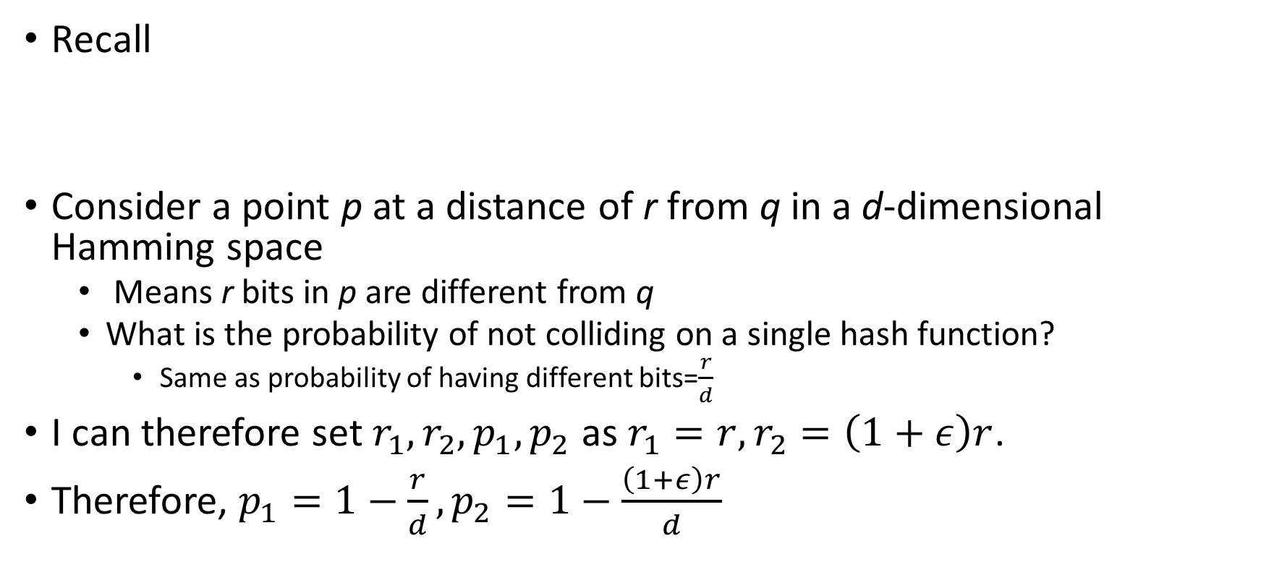
Properties of hash functions in Hamming Space
Recall
Consider a point p at a distance of r from q in a d-dimensional Hamming space
Means r bits in p are different from q
What is the probability of not colliding on a single hash function?
Same as probability of having different bits=$\frac{r}{d}$
I can therefore set $r_{1},r_{2}, p_{1},p_{2}$ as $r_{1}=r, r_{2}=\left(1+ε\right)r$.
Therefore, $p_{1}=1−\frac{r}{d}, p_{2}=1−\frac{\left(1+ε\right)r}{d}$

Slide 52
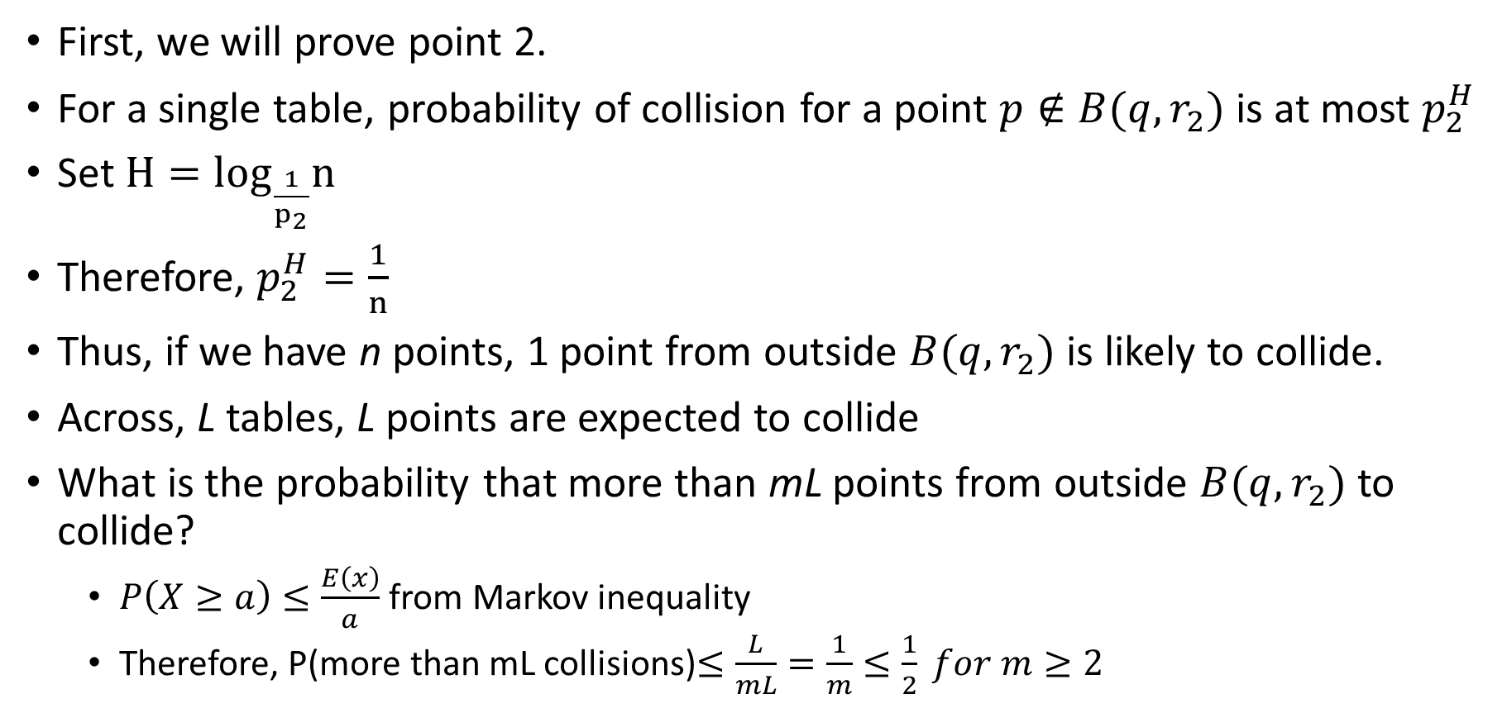
Proof
First, we will prove point 2.
For a single table, probability of collision for a point $p∉B(q,r_{2})$ is at most $p_{2}^{H}$
Set $H=\log_{\frac{1}{p_{2}}}n$
Therefore, $p_{2}^{H}=\frac{1}{n}$
Thus, if we have n points, 1 point from outside $B(q,r_{2})$ is likely to collide.
Across, L tables, L points are expected to collide
What is the probability that more than mL points from outside $B(q,r_{2})$ to collide?
$P\left(X≥a\right)≤\frac{E\left(x\right)}{a}$ from Markov inequality
Therefore, P(more than mL collisions)$≤\frac{L}{mL}=\frac{1}{m}≤\frac{1}{2} for m≥2$

Slide 53
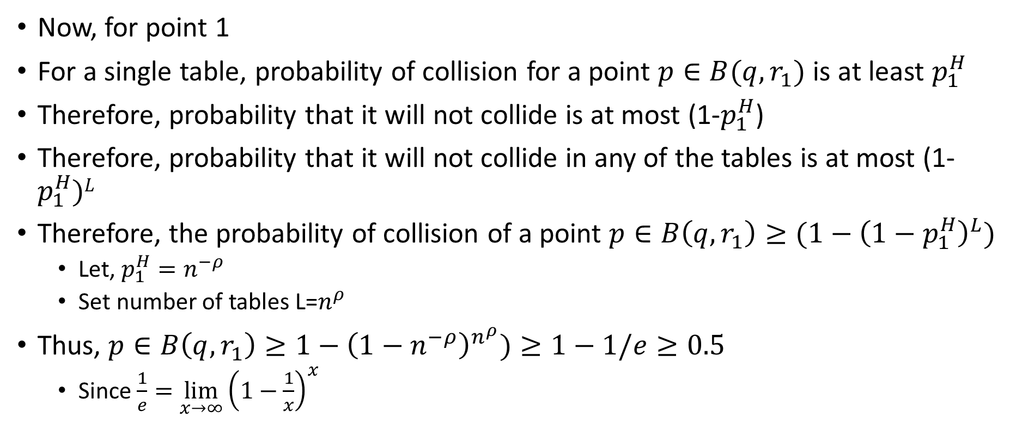
Proof
Now, for point 1
For a single table, probability of collision for a point $p∈B(q,r_{1})$ is at least $p_{1}^{H}$
Therefore, probability that it will not collide is at most (1-$p_{1}^{H}$)
Therefore, probability that it will not collide in any of the tables is at most (1-$p_{1}^{H})L$
Therefore, the probability of collision of a point $p∈B\left(q,r_{1}\right)≥(1−{\left(1−p_{1}^{H}\right)}^{L})$
Let, $p_{1}^{H}=n^{−ρ}$
Set number of tables L=$n^{ρ}$
Thus, $p∈B\left(q,r_{1}\right)≥1−{\left(1−n^{−ρ}\right)}^{n^{ρ}})≥1−1/e≥0.5$
Since $\frac{1}{e}=\lim_{x→∞}{{\left(1−\frac{1}{x}\right)}^{x}}$

Slide 54
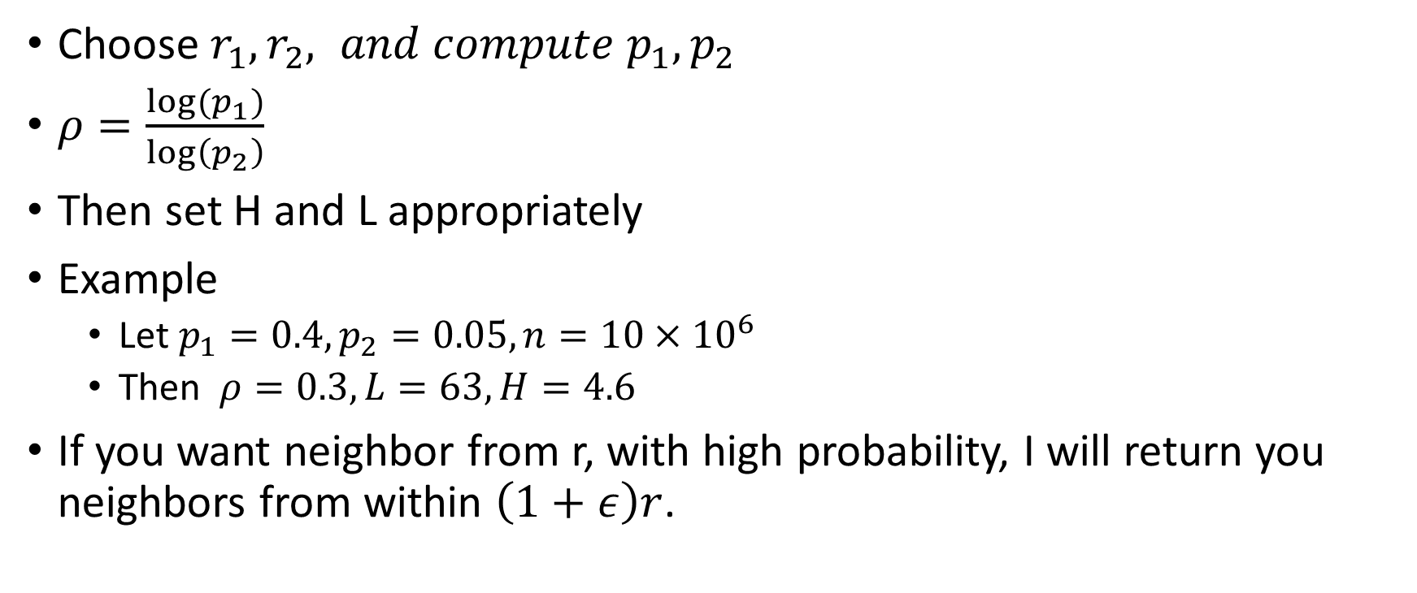
Numbers..
Choose ${r_{1},r_{2}, and compute p}_{1}, p_{2}$
$ρ=\frac{{log(p}_{1})}{\log\left(p_{2}\right)}$
Then set H and L appropriately
Example
Let $p_{1}=0.4, p_{2}=0.05, n=10×{10}^{6}$
Then $ρ=0.3, L=63, H=4.6$
If you want neighbor from r, with high probability, I will return you neighbors from within $\left(1+ε\right)r$.

Slide 55
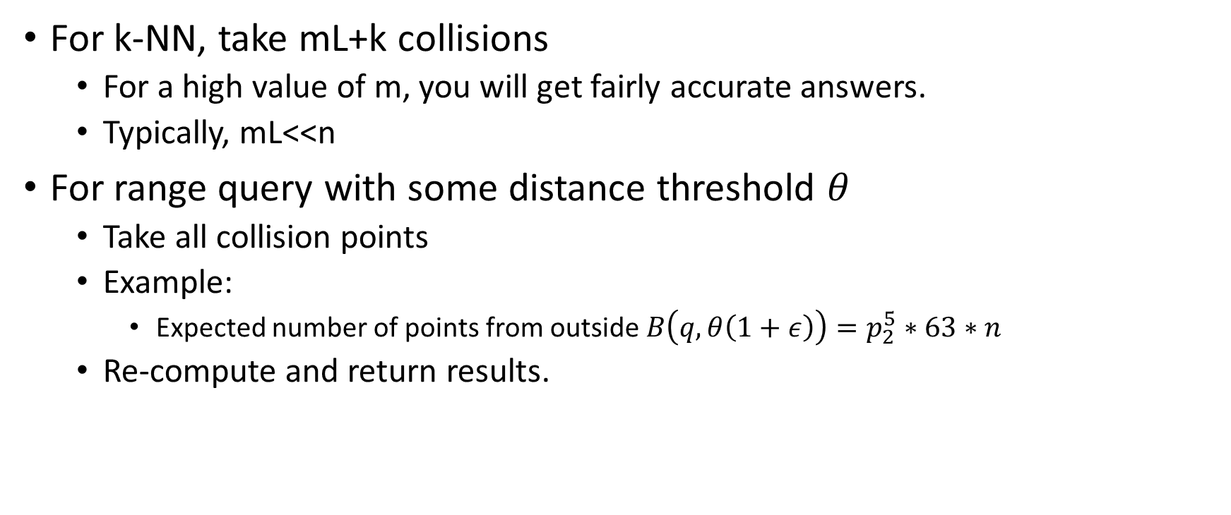
Querying
For k-NN, take mL+k collisions
For a high value of m, you will get fairly accurate answers.
Typically, mL<<n
For range query with some distance threshold $θ$
Take all collision points
Example:
Expected number of points from outside $B\left(q,θ\left(1+ε\right)\right)=p_{2}^{5}∗63∗n$
Re-compute and return results.

Slide 56
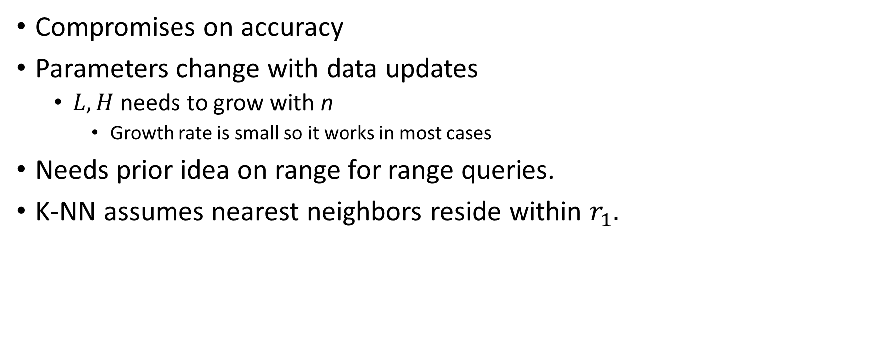
Weaknesses
Compromises on accuracy
Parameters change with data updates
$L, H$ needs to grow with n
Growth rate is small so it works in most cases
Needs prior idea on range for range queries.
K-NN assumes nearest neighbors reside within $r_{1}.$

